Slide 1
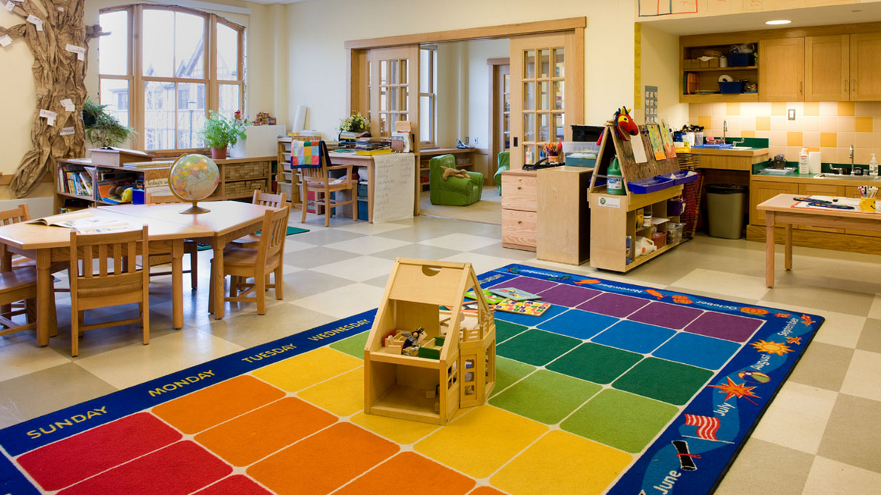

When I say goodbye to my family at preschool
Developed by KU Children’s Services Sector Capacity Building Program with funding from the NSW Department of Education.

Slide 2
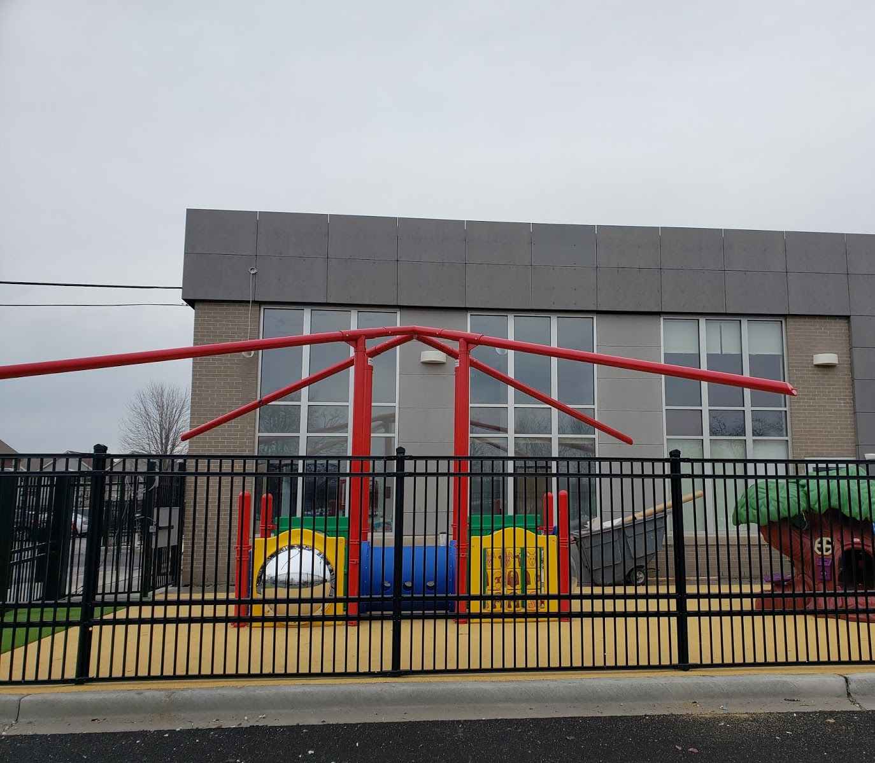
My family take me to preschool in the morning.

Slide 3
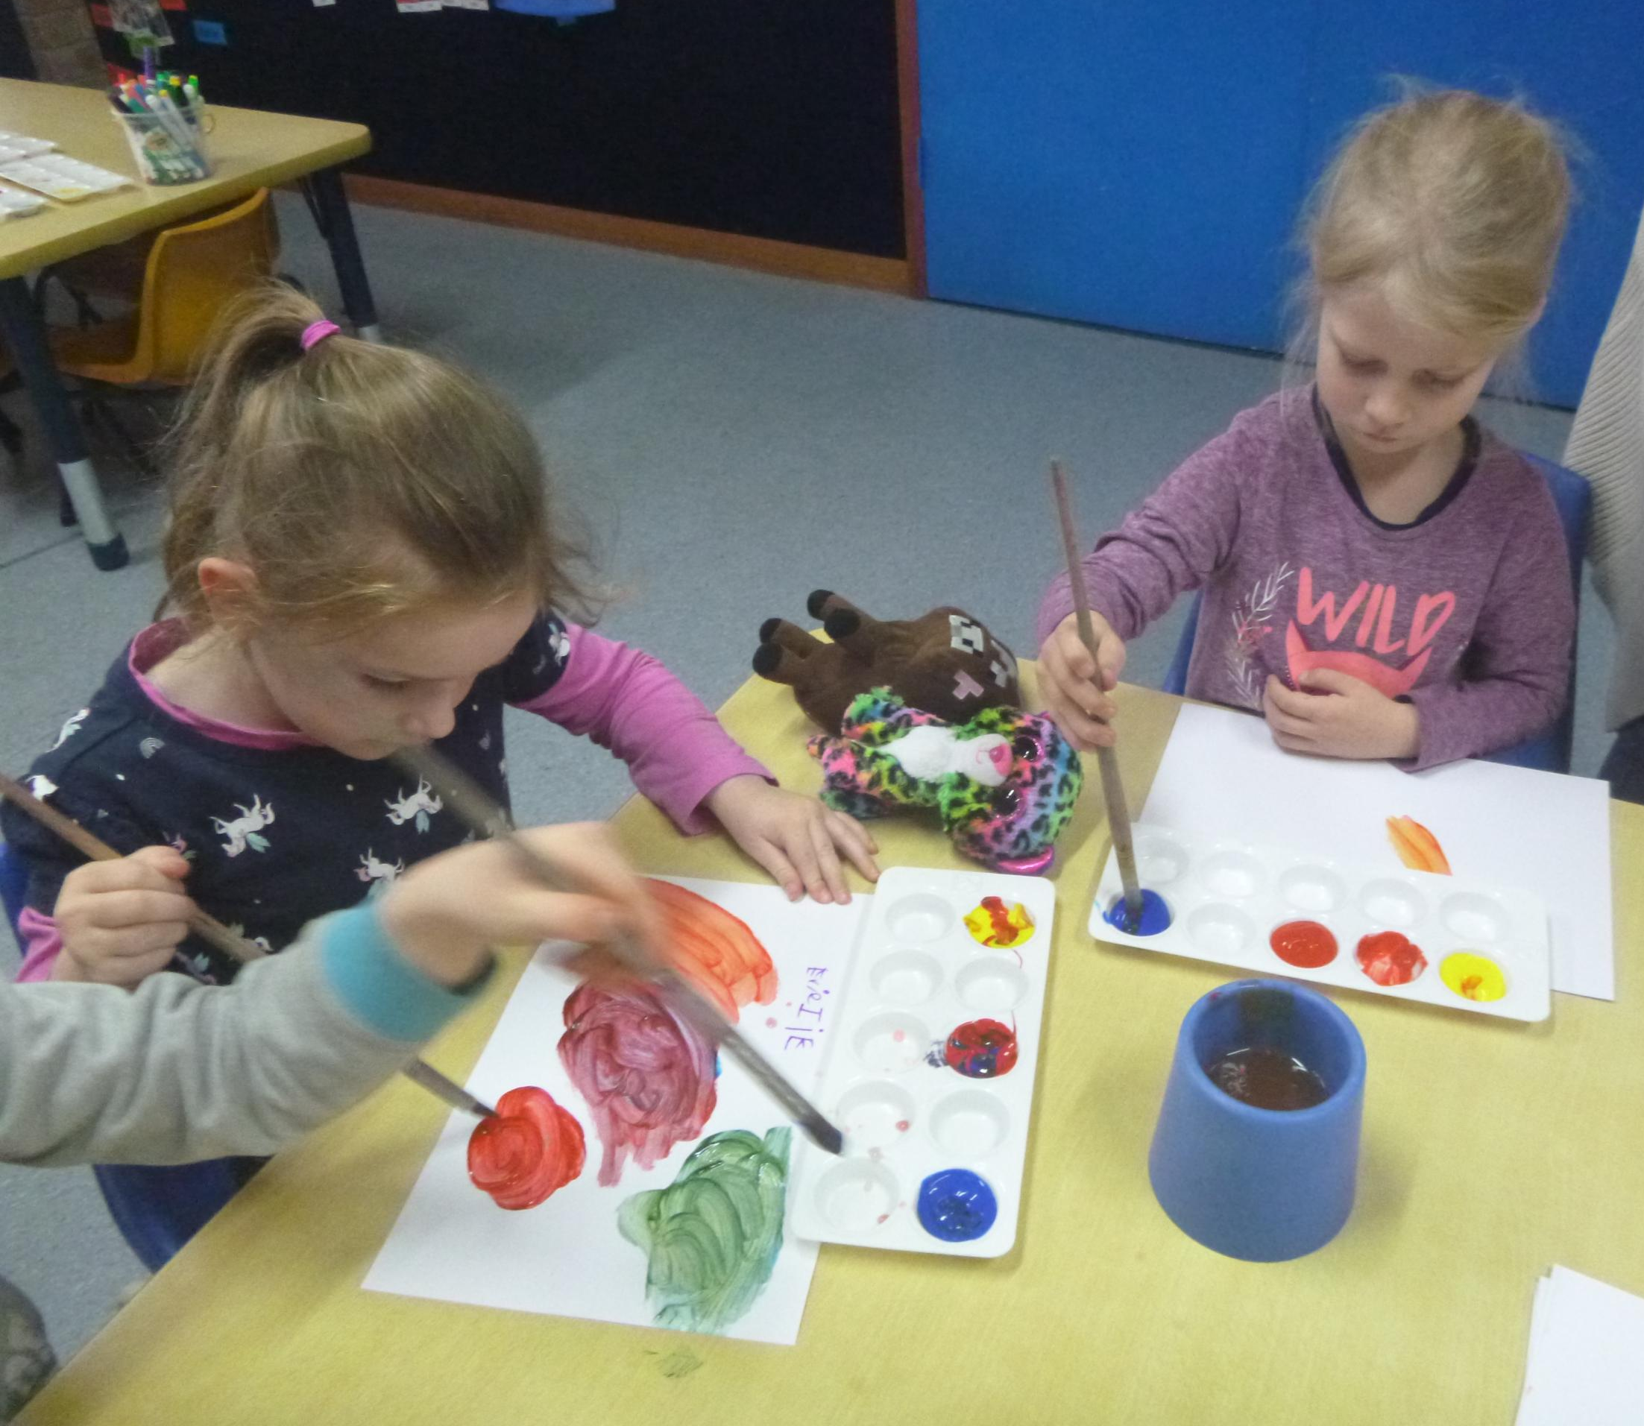
It is my job to go to preschool.
I go to preschool to learn, play and have lots of fun.

Slide 4
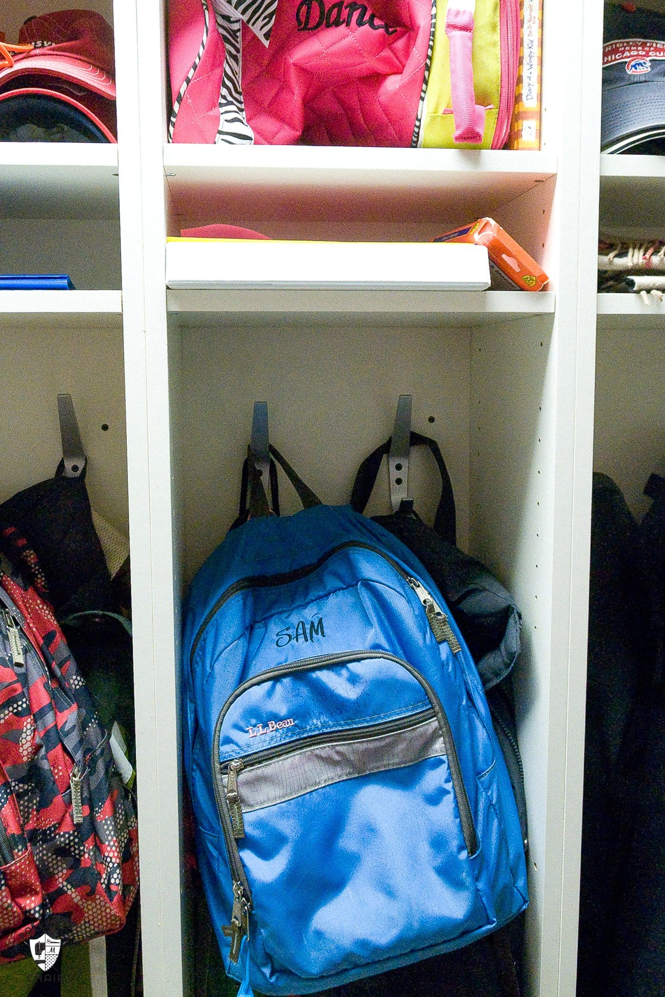
I say goodbye to my family once I have put my bag away.

Slide 5
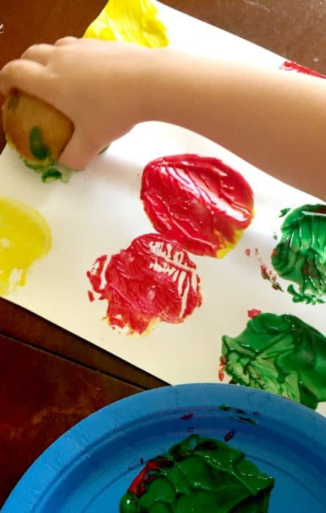
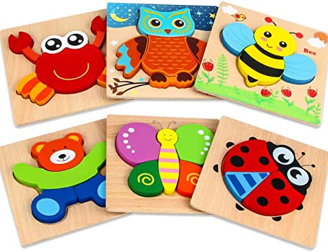
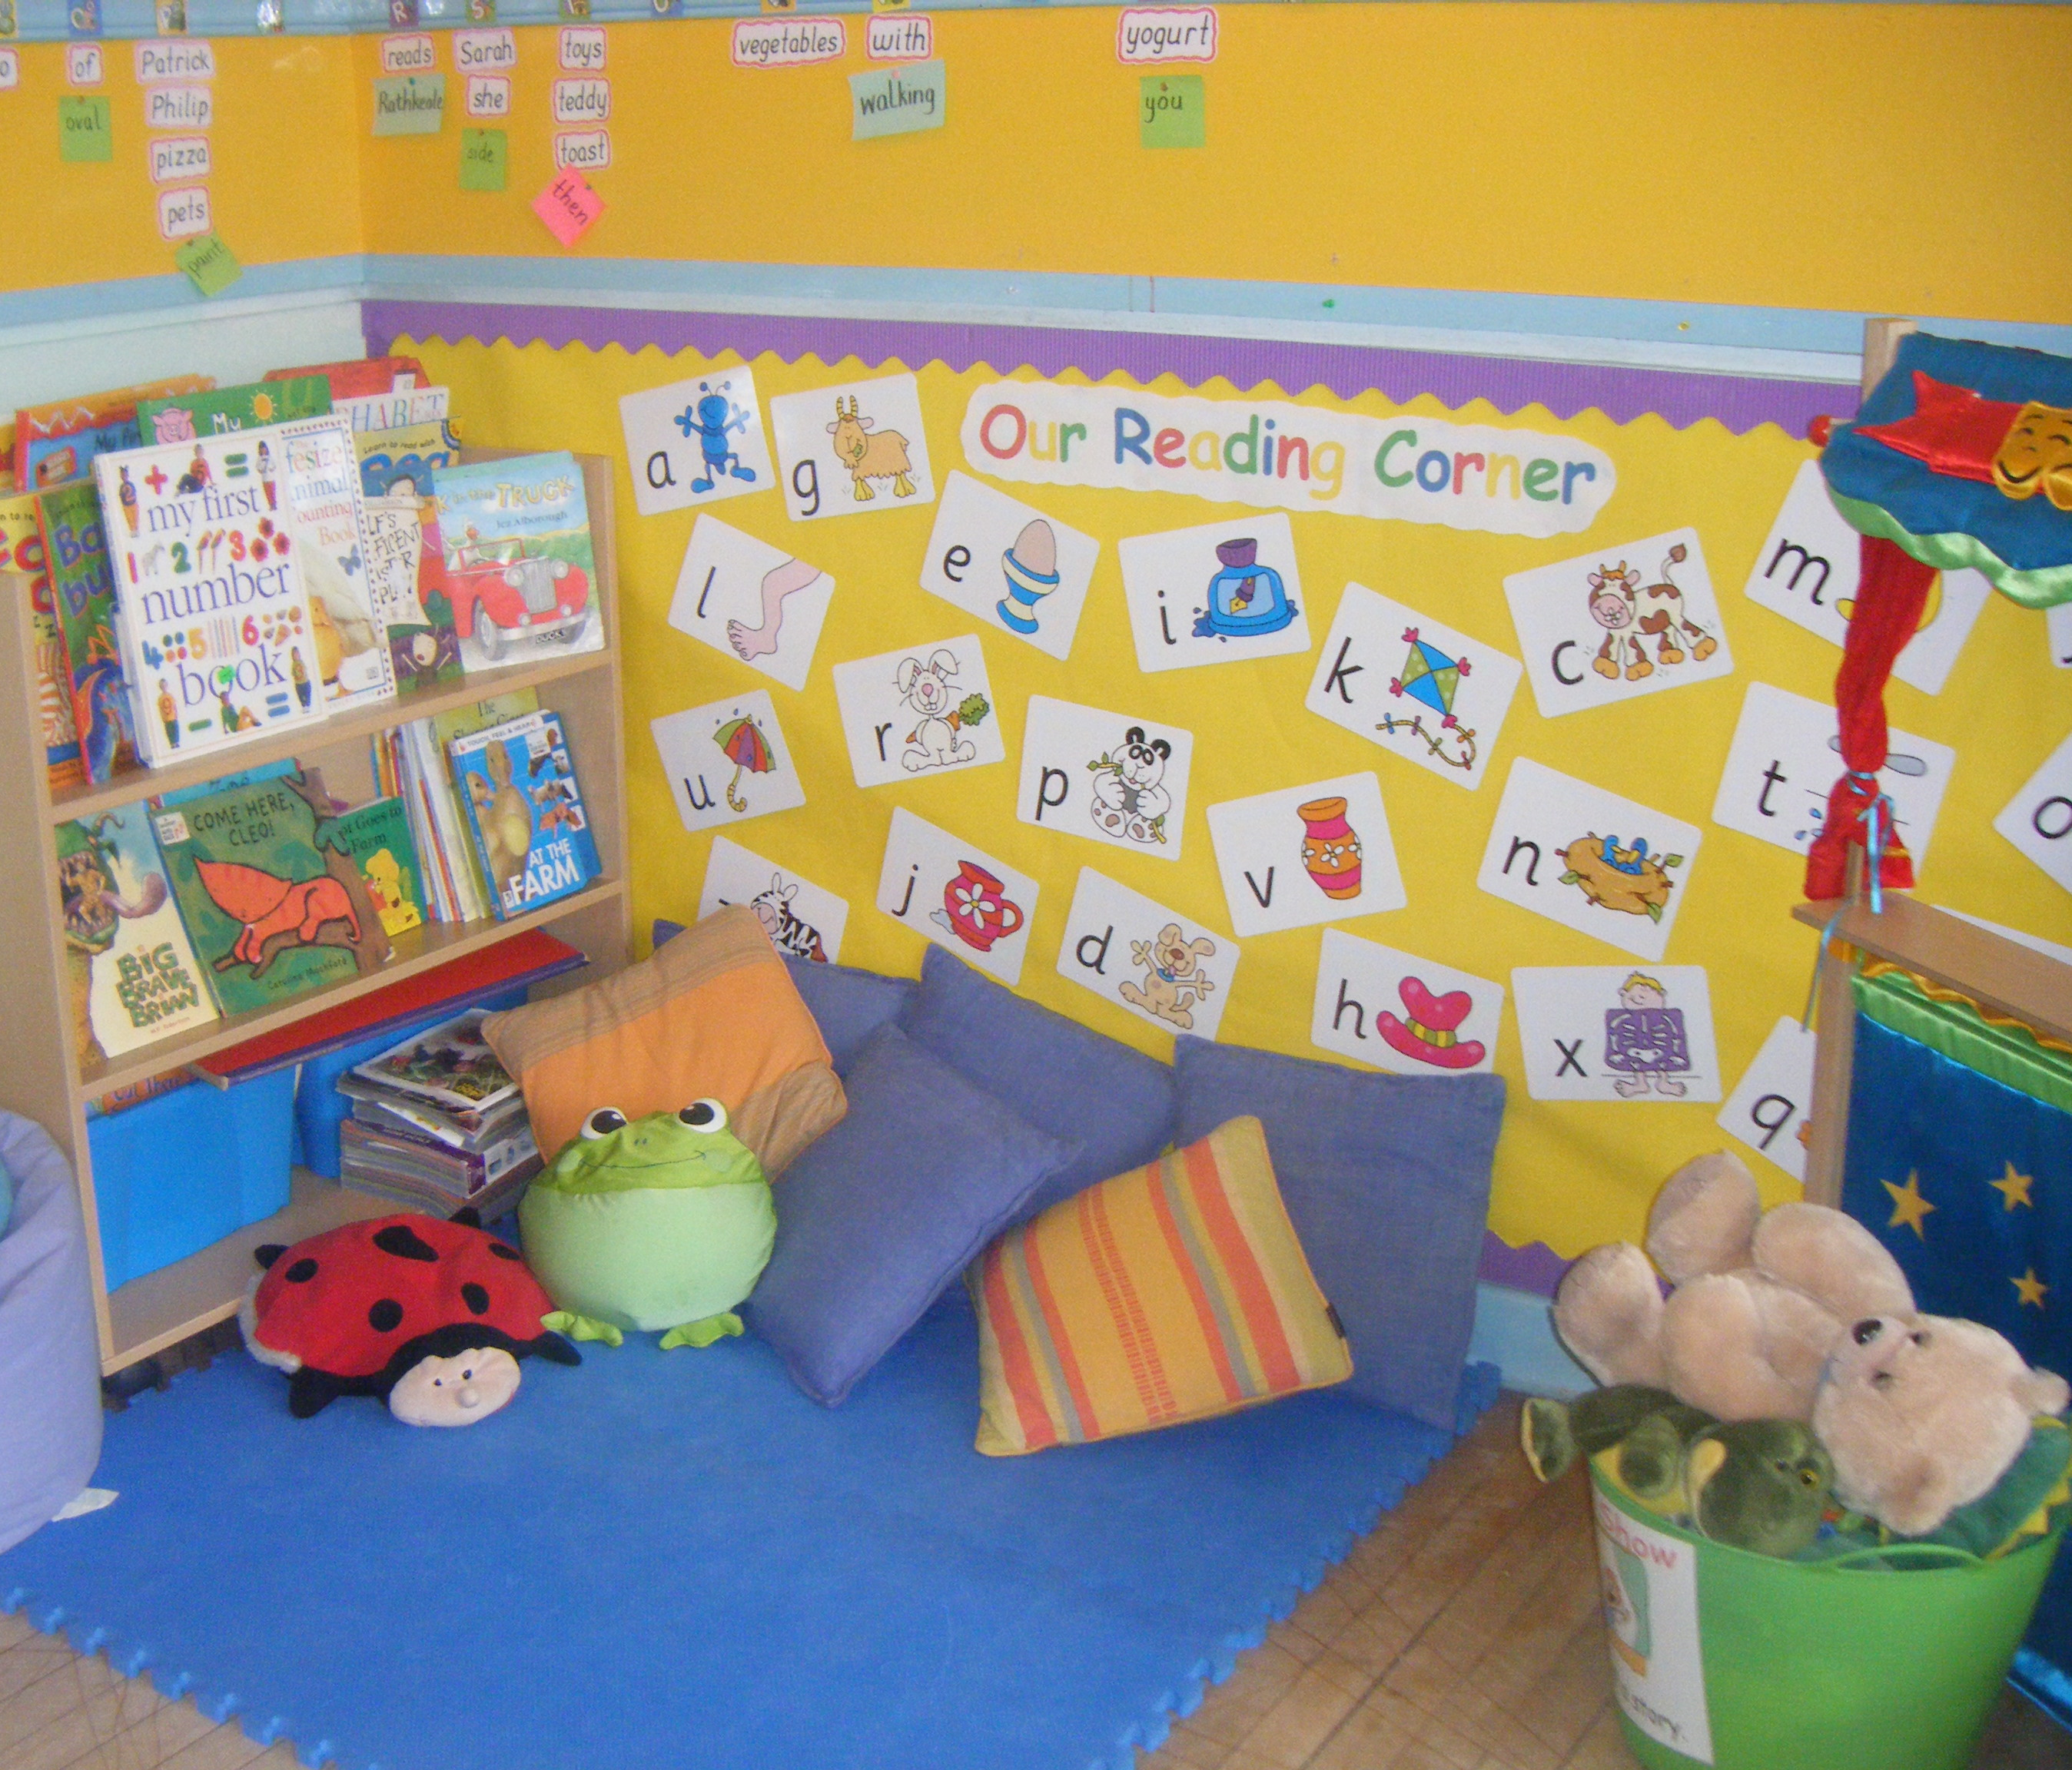
I can choose a favourite activity or spend some time in the quiet area.

Slide 6
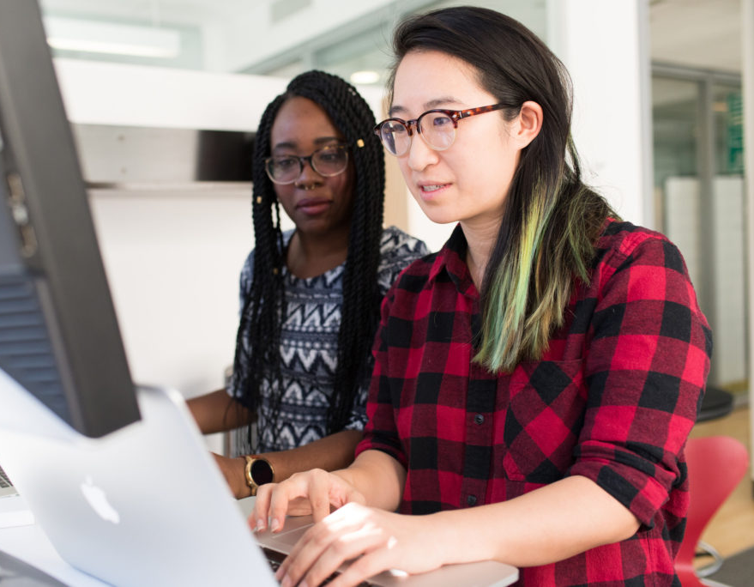
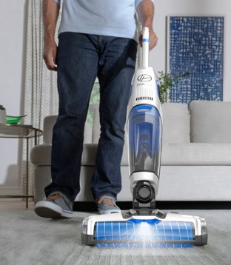
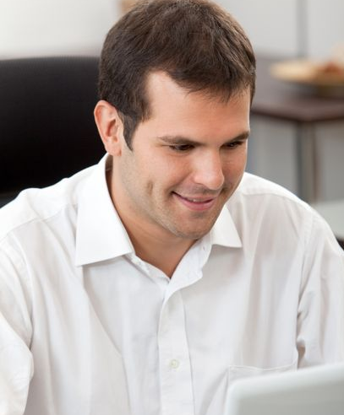
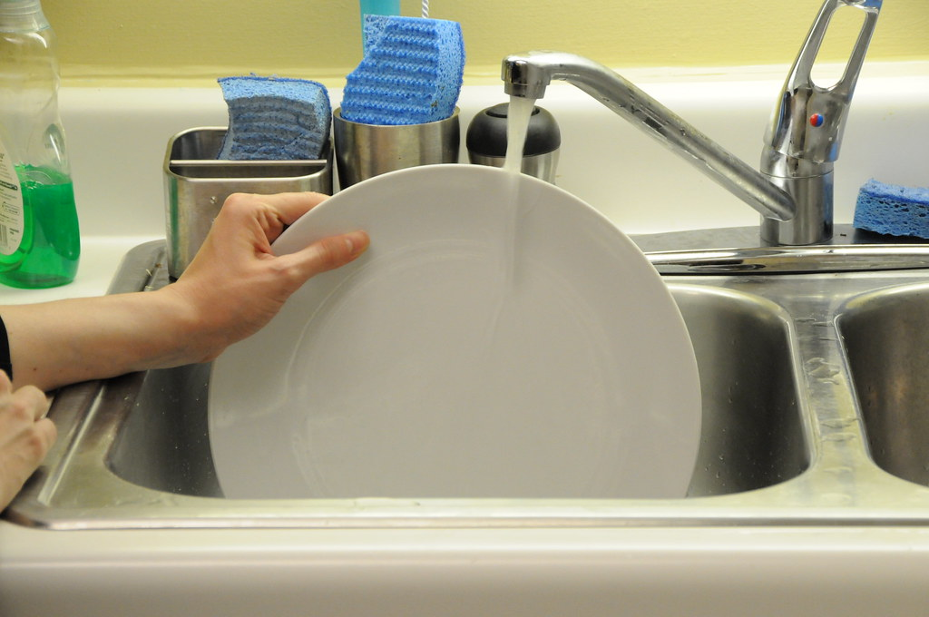
My family have jobs to do. They will go to work or do some jobs at home.
My family are safe and happy when they are doing their jobs.

Slide 7
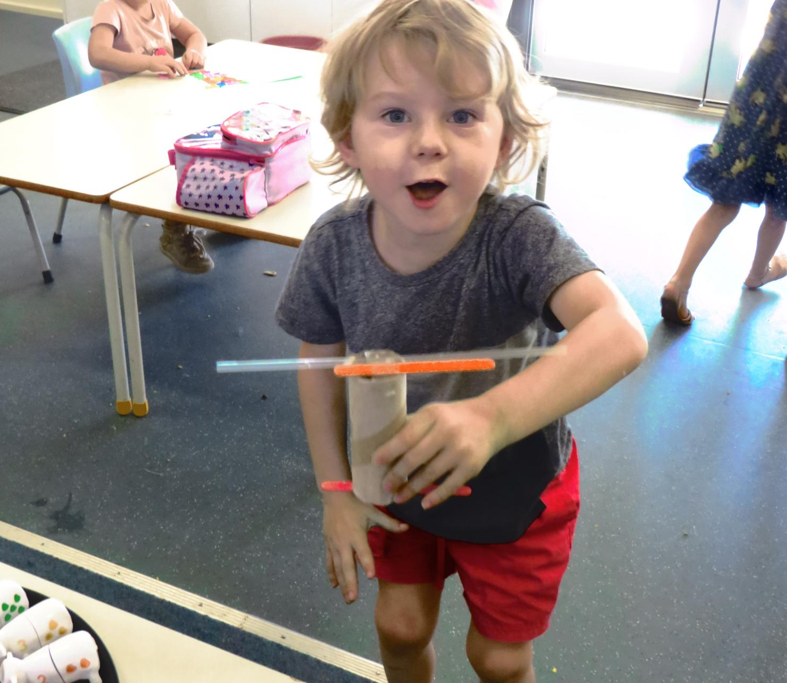
I can play and learn at preschool while my family are doing their jobs.

Slide 8
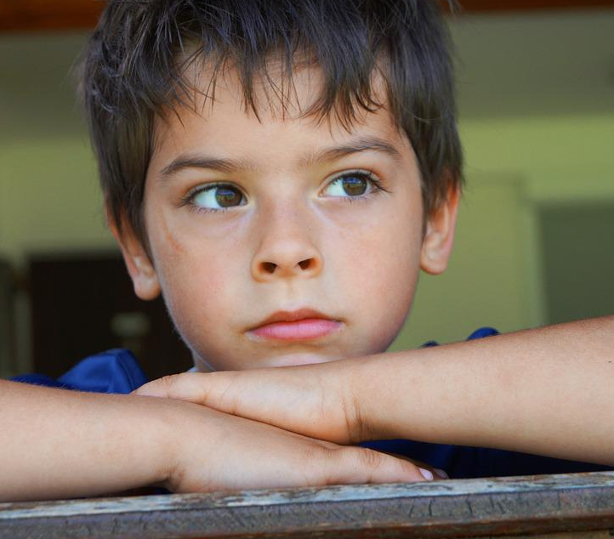
Sometimes I feel worried or scared when my family say goodbye and leave preschool.
Insert photo of children leaving preschool.

Slide 9
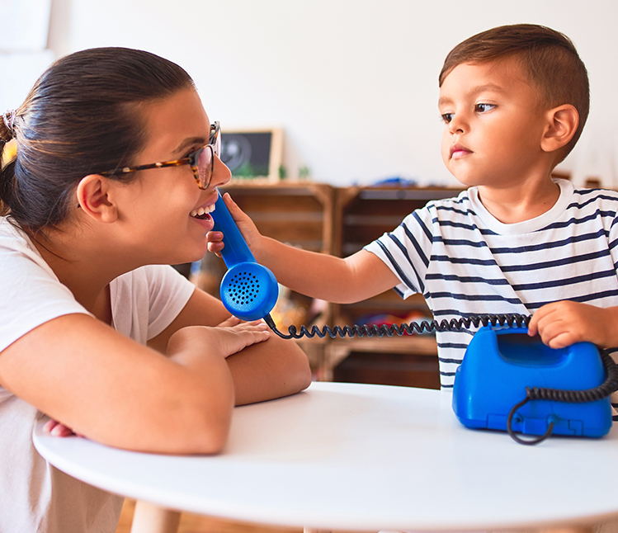
When I feel worried or scared, I can talk to a teacher. I can check the timetable and see when my family will come back.

Slide 10
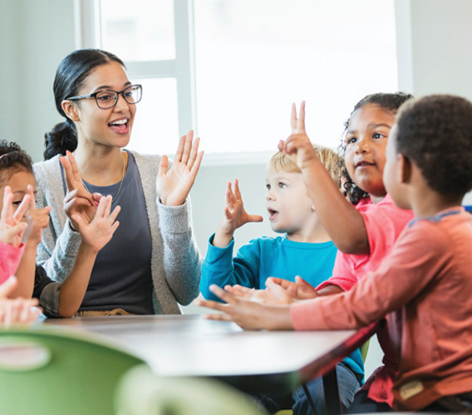
My teachers look after me at preschool. They will comfort me when I feel worried or scared. They keep me safe. They like to play lots of fun games with me at preschool.

Slide 11
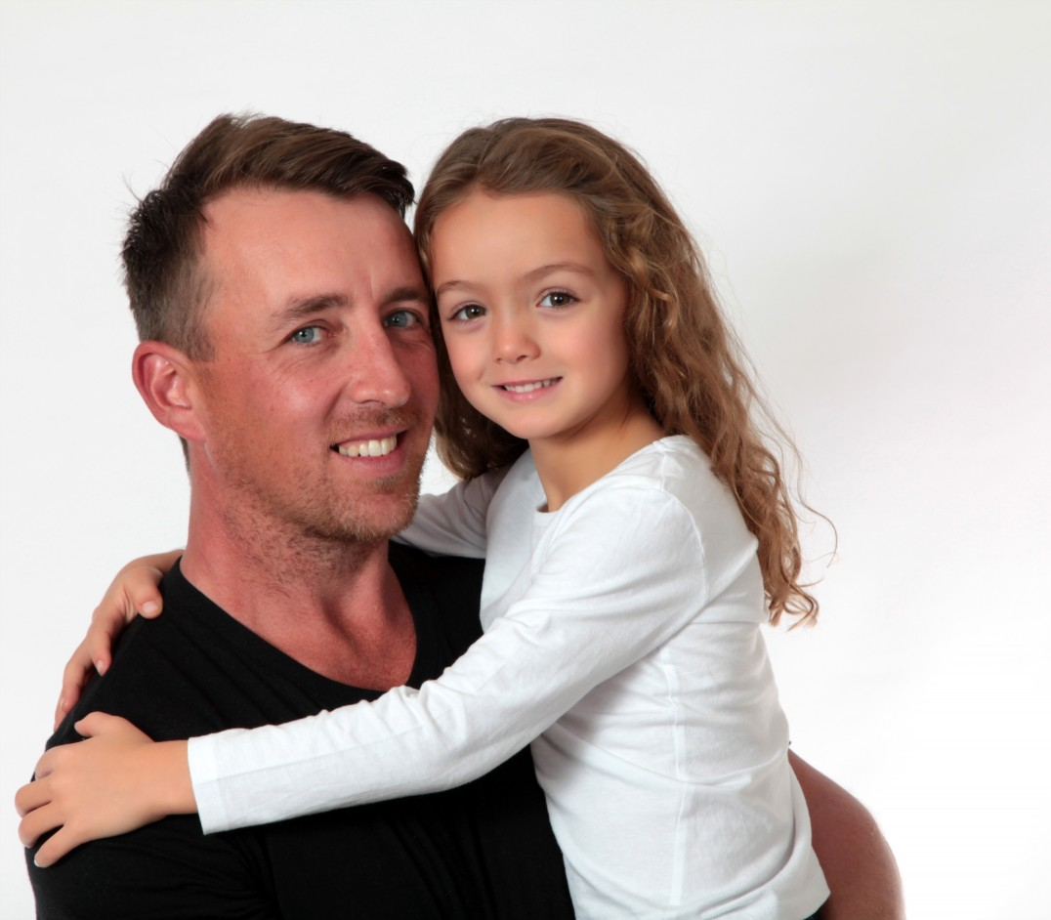
My family will be back to pick me up in the afternoon when their jobs are finished.

Slide 12
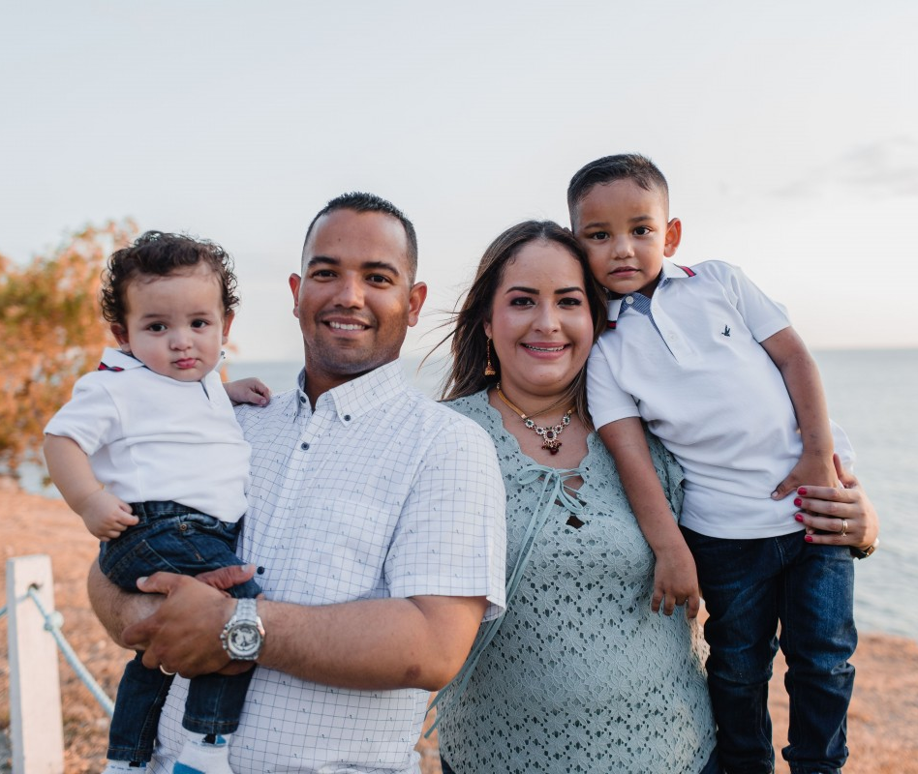
My family will always come back and pick me up. Everyone is happy when I have fun and play at preschool.

